Slide 1


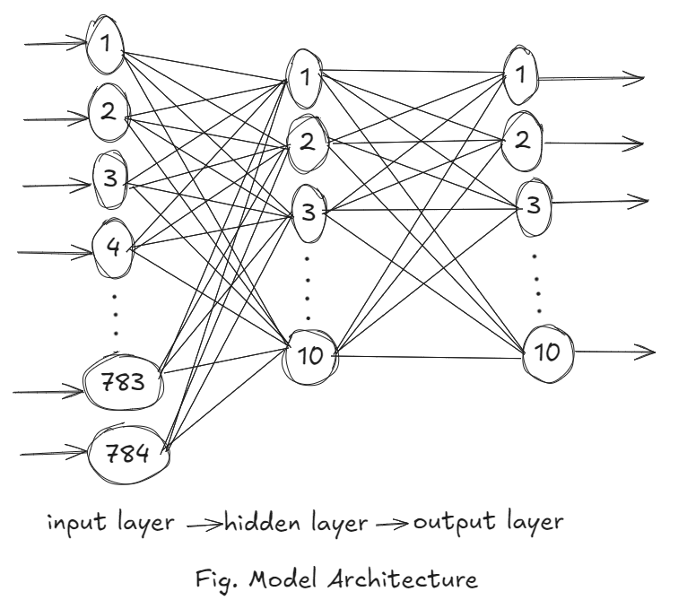
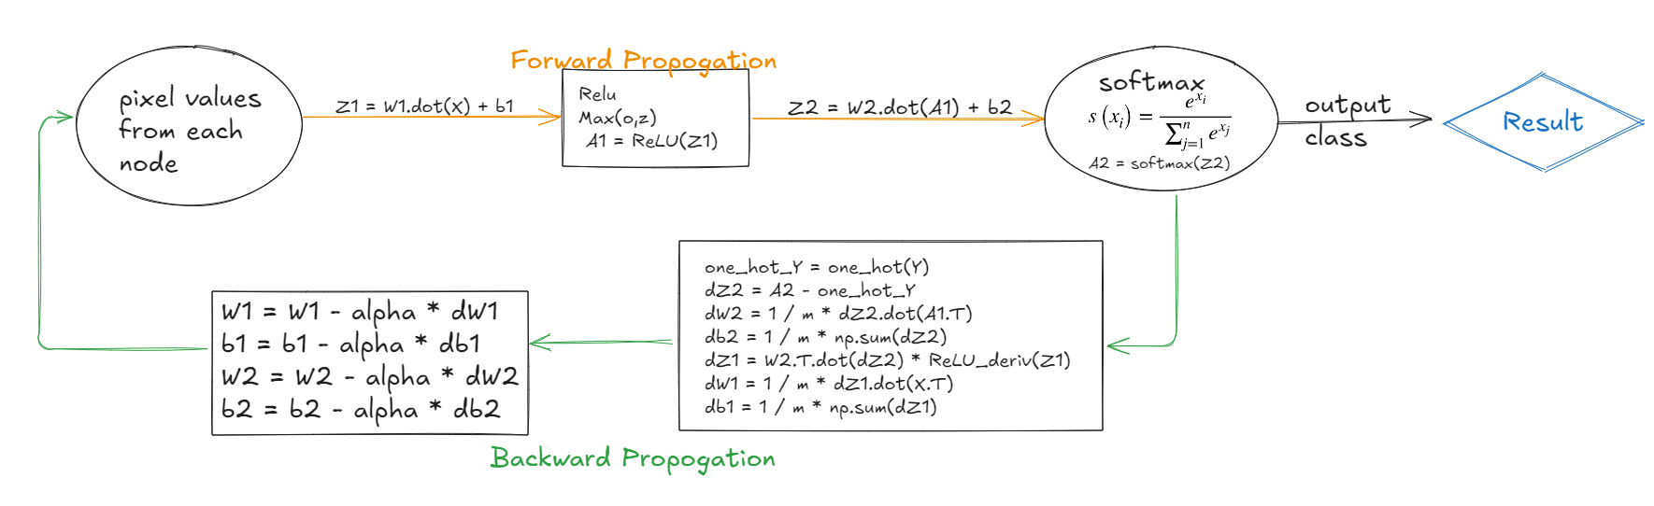
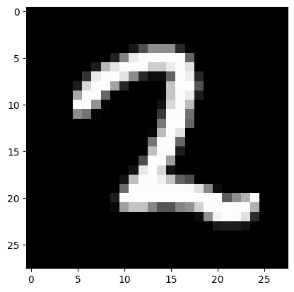
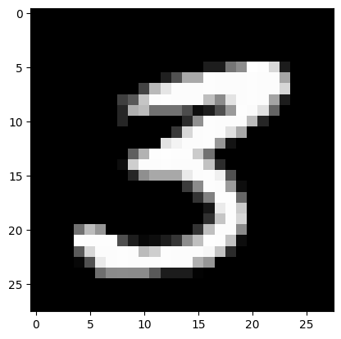
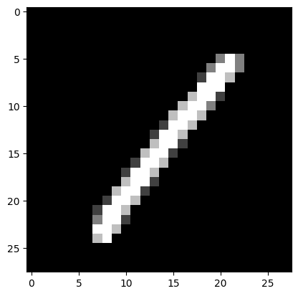
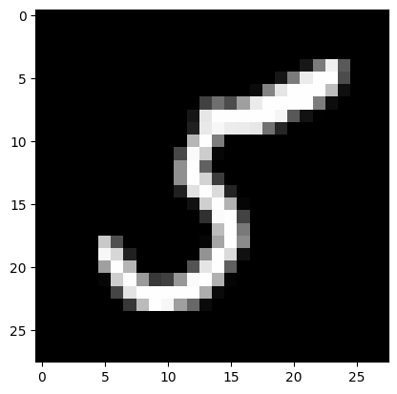
Bharati Vidyapeeth Deemed to be University),
College of Engineering, Pune
Department of Computer Science and Engineering
Rishav Parasar, Tanishk Sonani, Shreesh Kulkarni, Aditya Mishra
Guide Name: Dr Nisha Auti
Digit Recognition System using ANN
Project Summary
Implementation Diagram
Objective and Scope: This project focuses on building an Artificial Neural Network (ANN) for handwritten digit recognition using the MNIST dataset, which contains 70,000 grayscale images of 28x28 pixels. The aim is to develop a multi-layer perceptron (MLP) model to classify these digits (0–9) by training on labeled data. The project involves data preprocessing, model construction, and implementing training algorithms to optimize classification accuracy.
Key Components and Methodology: The ANN includes an input layer, a hidden layer with ReLU activation, and an output layer using softmax for multi-class classification. Forward propagation calculates predictions, while backpropagation adjusts weights and biases through gradient descent. One-hot encoding, weight initialization, and learning rate tuning are used to enhance performance. The network is trained over several epochs, improving its ability to classify digits from raw pixel data.
Evaluation and Results: The trained ANN is tested on unseen data and evaluated using metrics like accuracy, precision, and confusion matrices. Sample images are used to verify the model’s ability to correctly classify handwritten digits. This project demonstrates the effectiveness of neural networks in image classification tasks, such as optical character recognition (OCR).
Model Architecture
Input Layer:
28x28 = 784 neurons:
Each neuron represents a pixel of the 28x28 grayscale image (from the MNIST dataset).
The pixel values range from 0 to 255, which are normalized to [0, 1].
Hidden Layers:
Hidden Layer 1:
128 neurons
Activation Function: ReLU (Rectified Linear Unit)
ReLU is used to introduce non-linearity, ensuring the model can learn complex patterns.
Hidden Layer 2 :
64 neurons
Activation Function: ReLU
Adds another layer of abstraction, enabling the network to learn deeper features from the input images.
Output Layer:
10 neurons
Each neuron corresponds to one of the digits (0-9).
Activation Function: Softmax
Converts the raw output into a probability distribution over the 10 digit classes.
The class with the highest probability is selected as the predicted digit.
Outcome
Prediction: [2]
Prediction: [3]
Applications
Optical Character Recognition (OCR):
Used for digitizing handwritten documents, forms, and manuscripts.
Improves automation in banking for cheque processing by recognizing handwritten digits.
Postal Code Recognition:
Postal services use digit recognition to automatically sort mail based on handwritten postal codes.
Automated Form Processing:
Government and private institutions use digit recognition to automate the digit extraction from filled forms (e.g., tax forms, surveys).
Banking and Financial Systems:
Used in ATMs for processing handwritten deposit slips or checks, recognizing handwritten account numbers and amounts.
License Plate Recognition:
Traffic management systems use digit recognition to identify vehicle registration numbers for surveillance and toll collection.
Prediction: [1]
Prediction: [5]

